Slide 1
3D Human Pose Estimation
Yusuf Metin ÖZER 221805079

Slide 2
Introduction
Human pose estimation is a computer vision task where the goal is to detect the location of specific keypoints like hands , elbows, head, etc.
In general a model-based technique is used to represent and infer human body poses in 2D and 3D space. I will use 3D space estimation.
Model takes image or video as input and generates keypoints in format like COCO than we can do necessary operations on them. Example of these operations can be drawing silhouette of estimated keypoints on top of given input.

Slide 3
Use Cases
Even though there is limitless use cases of human pose estimation, I given some examples below:
human-computer interaction
action recognition
motion capture
Games
Animation
movement analysis
augmented reality
sports and fitness
robotics

Slide 4
Technical Details
Mediapipe supply us pretrained models (tasks) for prototyping easily. Some of the tasks is more demanding than the others but they supply compatible task file for almost all devices.
As well as using pretrained models, some of the task categories we can develop and train our own model. But this is not possible in case of human pose estimation task using MediaPipe (There is no documentation or example about that) as far as I understand.
MediaPipe generates 33 3D keypoint using COCO template and does this in real-time.

Slide 5
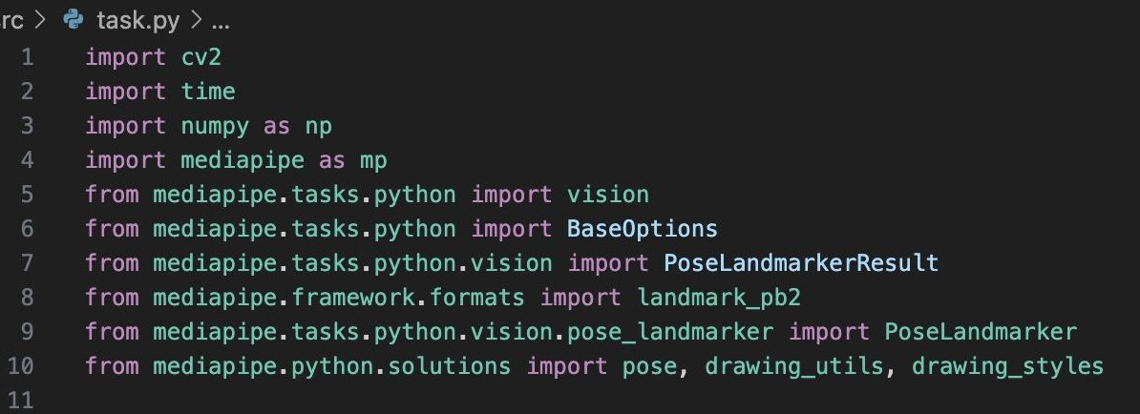
Code Insights (Imports)
Notes:
OpenCV, MediaPipe and NumPy imports

Slide 6
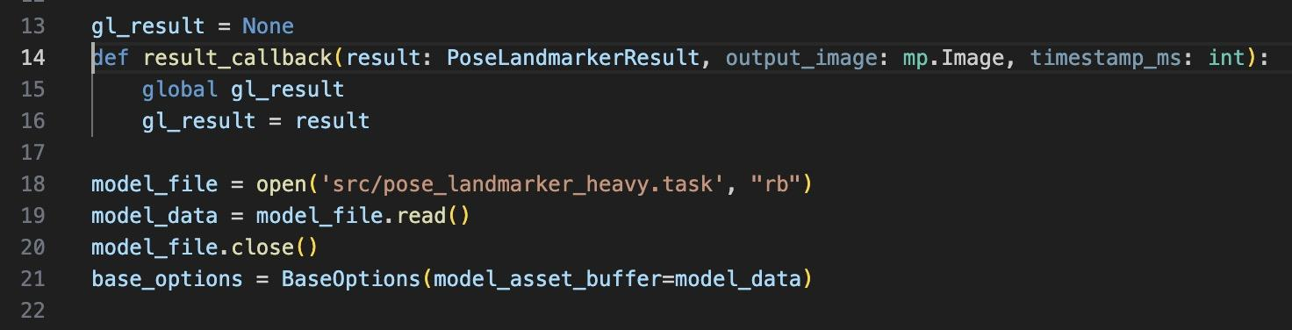
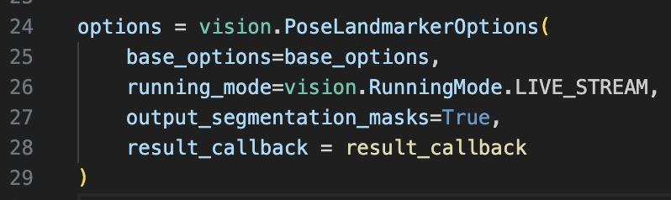
Code Insights (Globals)
Predicted keyframes passed to gl_result variable for later use (saving to file etc.)
pretrained model file reading for getting model data
Defining options for PoseLandmarker class.

Slide 7
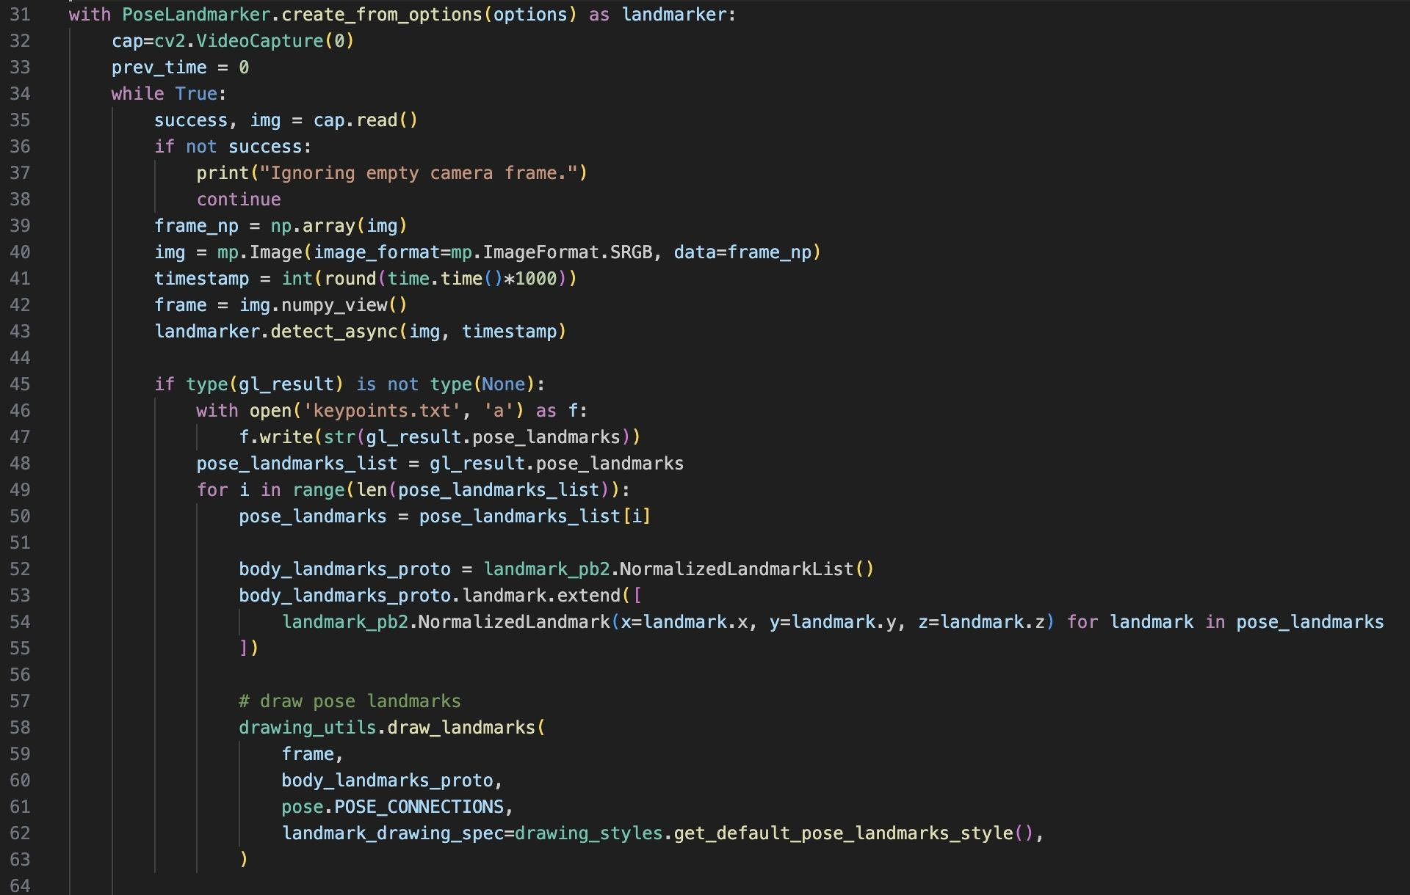
Code Insights (Video Capture Loop)
Checking video capture
Defining variable for passing to detect_async function of landmarker
Saving keypoint to file if results not empty
Drawing landmarks for each keypoints on top of input captured

Slide 8
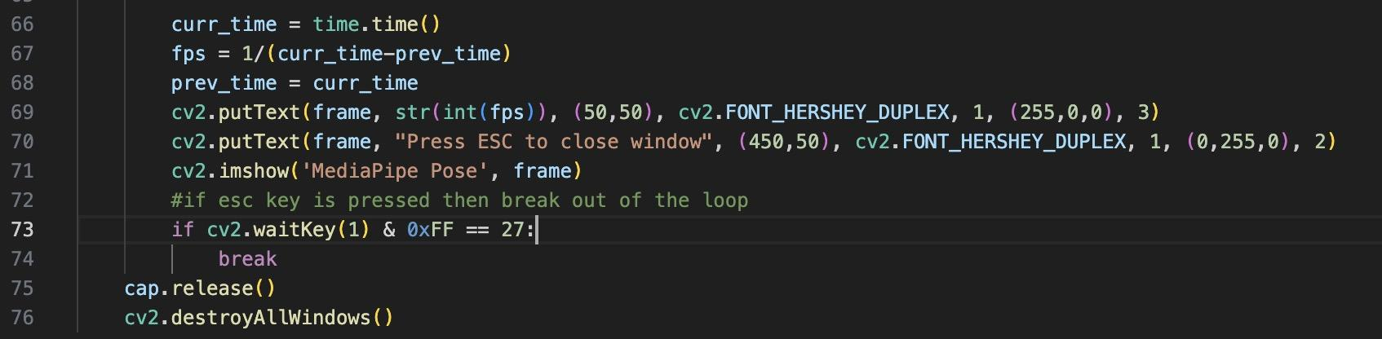
Code Insights (Window Texts and FPS)
Calculating FPS and adding some useful texts in the window.

